Slide 1
Randomized algorithm

Slide 2
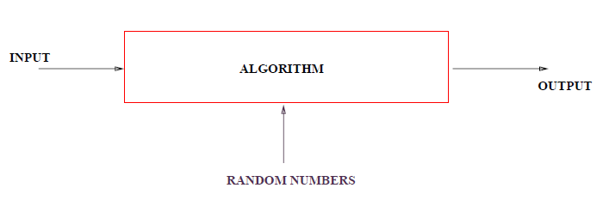
Randomized Algorithm
In addition to input , algorithm takes a source of random number and makes random choice during execution.

Slide 3
Pseudorandom numbers
The computer is not capable of generating truly random numbers
  The computer can only generate pseudorandom numbers--numbers that are generated by a formula
  Pseudorandom numbers look random, but are perfectly predictable if you know the formula
    Pseudorandom numbers are good enough for most purposes, but not all--for example, not for serious security applications.

Slide 4
Randomized Quick Sort
Instead of always using A[r] as the pivot, we will use a randomly chosen element from the subarray A[p . . r].
We do so by exchanging element A[r] with an element chosen at random from A[p . . r].
This modification, in which we randomly sample the range p, . . . , r, ensures that the pivot element x = A[r] is equally likely to be any of the r − p +1 elements in the subarray.
Because the pivot element is randomly chosen, we expect the split of the input array to be reasonably well balanced on average.

Slide 5
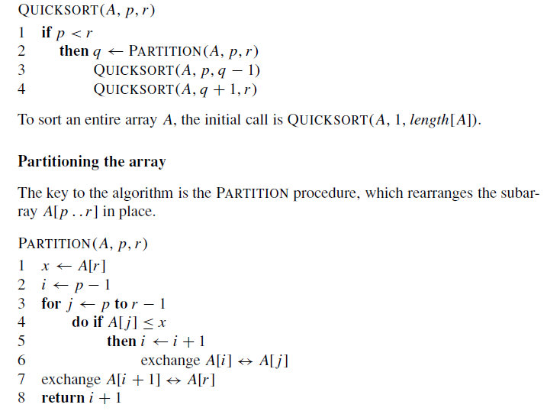
Simple Quick Sort

Slide 6
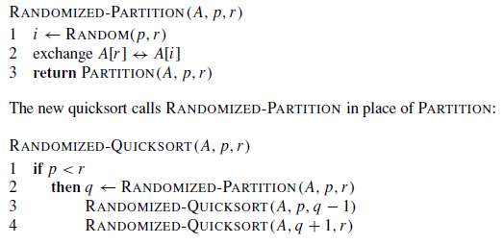
Randomized Quick Sort

